Slide 1
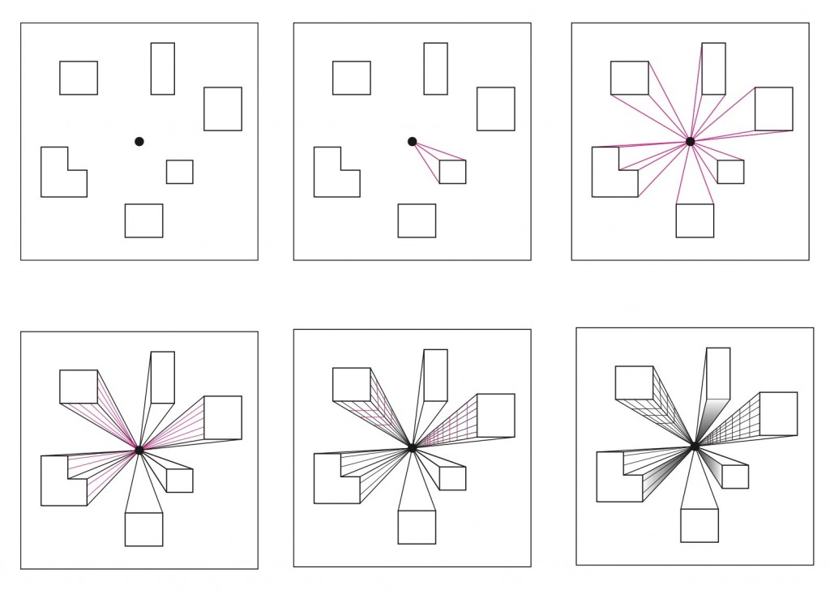
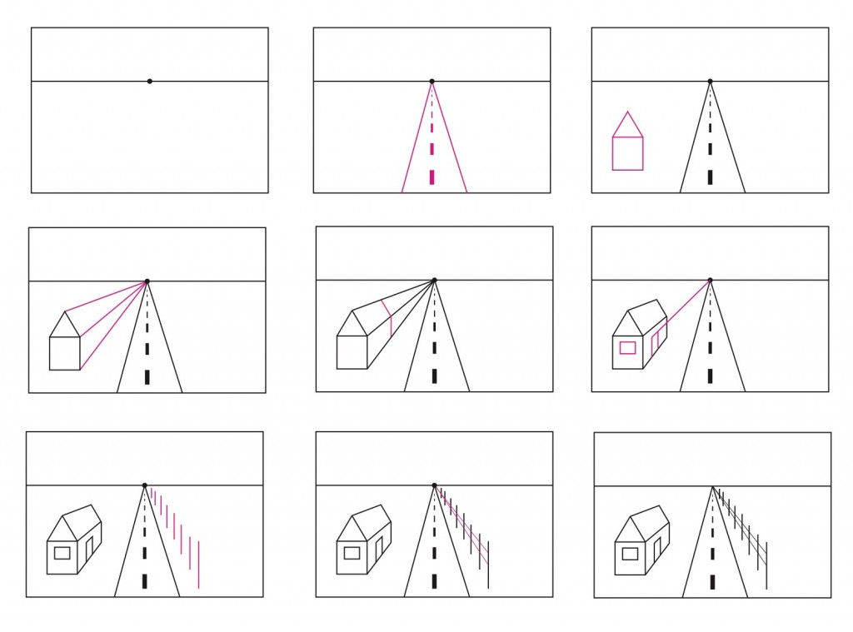
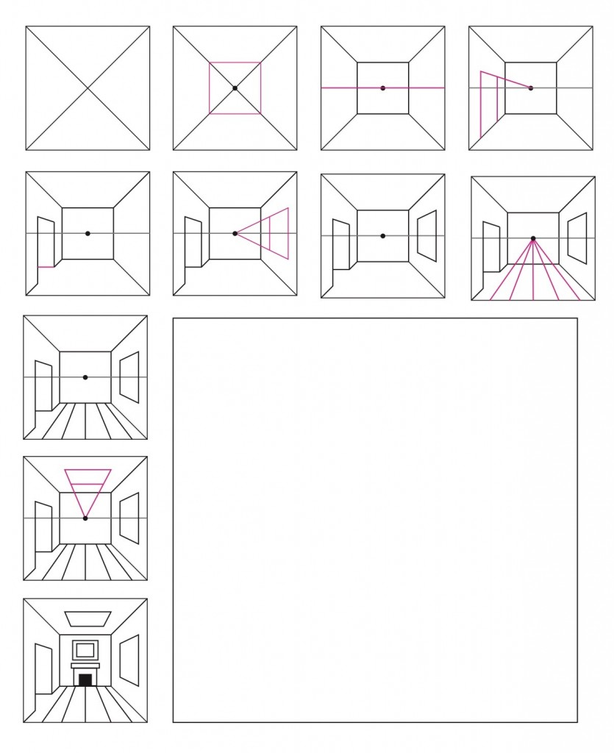
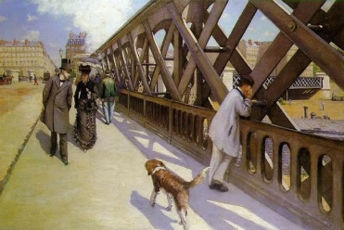
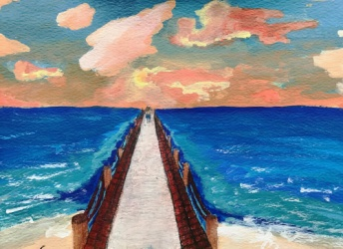
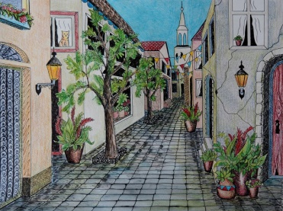
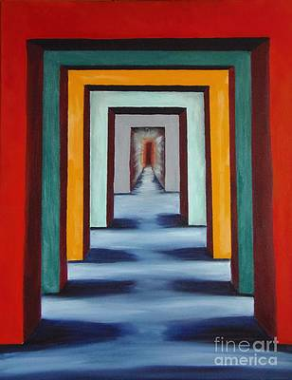
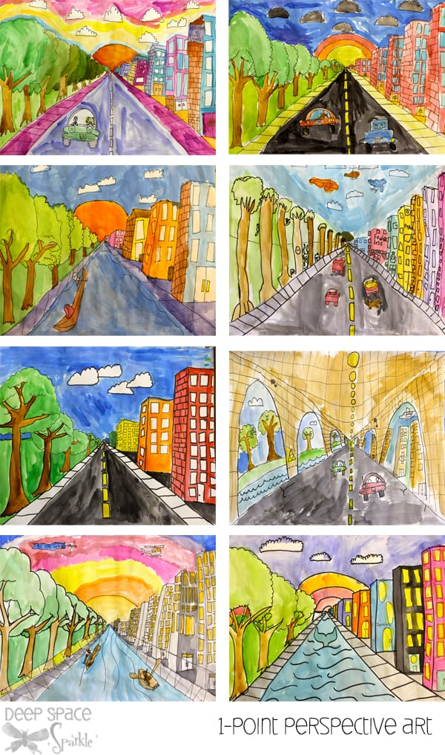
Knowledge Organiser Year 6 Art: One-Point Perspective Drawing
Concept: 3D form and perspective
One-point perspective – building shapes
One-point perspective with horizon line
Key Vocabulary
perspective | how we view or see something
one-point perspective | type of drawing created on a 2D plane that uses one point in the distance from which everything in the drawing is set out.
horizon line | ine that runs across the paper or canvas to represent the viewer's eye level, or show where the sky meets the ground.
eye level | the height of your eyes looking straight ahead; it is your reference point for drawing perspective lines.
vanishing point | the point at which receding parallel lines viewed in perspective appear to converge. (join together).
scale | the overall physical size of an artwork or objects in the artwork.
proportion | how the sizes of different parts of a piece of art or design relate to each other.
One-point perspective – room scene
Example one-Point perspective paintings
Example final pieces

