Slide 1
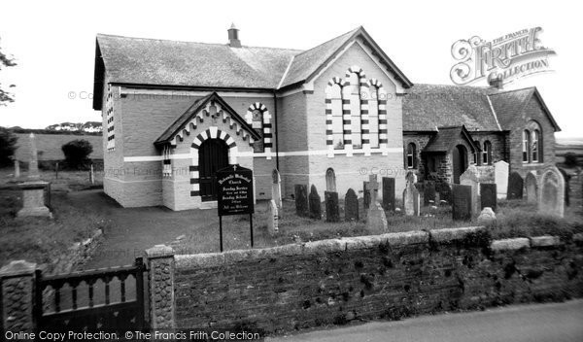
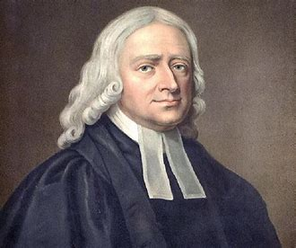
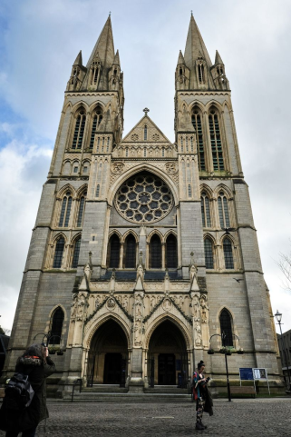
RE Knowledge Organiser Year 6: Does faith help people in Cornwall when life gets hard?
Concept – living a good life(RE2)
Key Vocabulary Methodist – someone who follows the teachings of John Wesley. Spiritual - Relating to religion or religious belief Gwennap Pit – place where John Wesley spoke. Tradition – belief passed from one generation to another. Reflect – think deeply and carefully about something.
Archaeologists are confident that humans have been pursuing avenues of spiritual inquiry in Cornwall for thousands of years. Evidence of this activity can be found in the Cornish landscape which is littered with quoits, stone circles, rows, menhirs, barrows and cairns.
The arrival and flowering of Christianity in Cornwall also shaped the landscape with Cornish saints establishing enclosed religious communities and ultimately creating a prevalence of settlements with a church at their centre.
Dobwalls Chapel c.1965
John Wesley
John Wesley visited Cornwall in 1743 and although he was attacked by people incited by the local clergy. He continued to preach from farms, barns and in the open air. Methodist chapels are still the hub of many communities.
Truro cathedral

