Slide 1
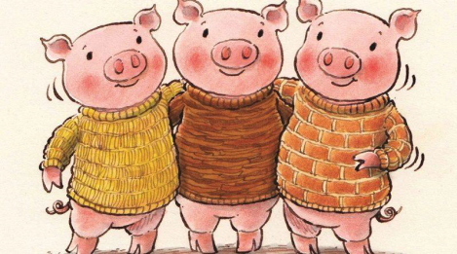
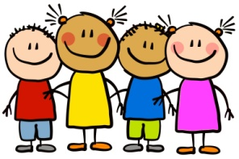
Dobwalls Primary School Medium Term Plan EYFS Autumn 1st half
Literacy
We will begin the new school year by reading and exploring the traditional story ‘The Three Little Pigs.’ Children will have the opportunity to re-enact the story and learn a short version of the story off by heart by following a set of pictures and actions. This is called the ‘story telling’ technique. We will also be enjoying and exploring other traditional tales such as Hansel and Gretel and The Ginger Bread Man. Once the children are settled in we will begin our phonics lessons. This half term, the children will learn a new sound every day. A sound sheet will be sent home each day to practice.
Maths
We will be following the White Rose maths guidance for EYFS Autumn Term. We will focus on understanding numbers up to 5 in depth. This will include counting to 5, finding number bonds for numbers to 5, finding more and less for numbers to 5, using a number line to 5 and adding and subtracting amounts up to 5. Lots of number based toys will be available for children during their continuous provision to deepen their understanding of number. We will also focus on sorting objects into groups of different criteria and begin to explore patterns in shape and number.
Personal, Social and Emotional Development
Our main focus will be settling into school life and making friends. We will support the children in forming friendships and learning each other’s names. We will also be learning how to keep safe in school by regularly washing hands and using good personal hygiene. All children will be thinking and talking about ‘what is special about me?’ They will have the opportunity to share their ‘all about me’ box or poster with the class. We will begin to explore our school Diamond Rules in circle time.
The 3 Little Pigs
All About Me
Physical Development
In the classroom and garden, there will be a wide range of equipment designed to develop the children’s fine and gross motor skills. Our ‘Finger Gym’ will have new challenges each day to support the children‘s hand strength in order to foster a strong pencil grip. We will be supporting the children do develop independent self care skills like putting shoes and coats on and going to the toilet. Once the children are full time, we will begin our ‘Leap into Life’ sessions. These are progressive physical development activities for young children.
Communication and language
For the first half term we will be developing listening, understanding and speaking skills through small group discussions about our topics. Children will be encouraged to talk in groups and during their play . We will introduce ‘the rhyme of the week’ and support children to learn rhymes off by heart.
Expressive Arts and Design
The learning environment will be full of opportunities for children to express themselves through play. The role play area will include elements from The Three Little Pigs story and new artistic equipment such as paint, salt dough and collage materials will be provided each week. The children will have the opportunity to explore ‘music making’ through our music sessions and ‘sound explorer’ box which contains a range of percussion instruments. We will invent group dances based on The Three Little Pigs.
Understanding the world
Children will be thinking about their own family and the things that are important to them. They will be able to talk about the things they enjoy and explore difference between families. We will be learning about Harvest Festival and what the celebration is about. Later on in the half term, the children will be naming basic parts of the body.
Our R.E focus story will be ‘David and Goliath.’
Wild Tribe
This half term we will be getting to know the Wild Tribe area and learning the safety rules. The children will be carrying out a range of scavenger hunts to focus on nature and natural materials. We will be making homes for the three little pigs.

