Slide 1
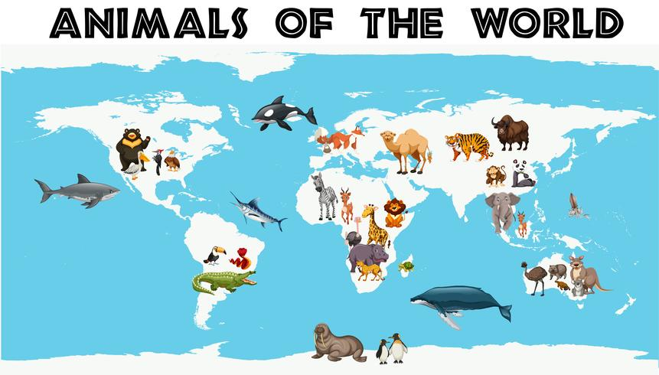
Dobwalls Primary School Medium Term Plan EYFS Spring 2nd half
Literacy
We will begin the half term by introducing our new story ‘The Very Hungry Caterpillar.’ The children will learn the text with a text map and change the caterpillar for an animal of their choice; perhaps a hedgehog or even a penguin! Once the children have learnt their modified text map, they will be using their phonic and red word knowledge to ‘have a go’ at writing their new stories. Our next focus story will be ‘The Fish Who Could Wish,’ where we will once again be innovating the story. RWI lessons will continue as usual with ‘sound of the day’ sheets being sent home daily.
Mathematics
In maths we will be continuing to work with numbers up to 10. We will be cementing the children’s understanding of adding, subtracting, comparing and finding number bonds with-in this range. We will be using a range of different mathematical resources to support a deep understanding of number, as well as now encouraging children to use their own jottings to solve number problems including the use of number sentences with the +, - and = symbols. This half term we will spend time focussing on the understanding of shapes. We will focus on positional language, special awareness, 2D and 3D shapes.
Personal, Social and Emotional Development
This half term we have some exciting new circle time activities to try. Our ‘rapidough’ sessions help the children to identify and explore a range of different feelings and emotions. We will be discussing when and why we feel different emotions and using the ‘bear emotion pictures’ and play dough to relate emotions to our own experiences. Our focus diamond rule is ‘care for everyone and everything.’
Physical Development
In our P.E sessions, we will be beginning by exploring a range of movement and dance focussed around animals. The children will have the opportunity to create their own dance based on an animal of their choice. We will also be enjoying some team games involving throwing, aiming and running in preparation for sports events in the summer term. Our finger gym will be updated weekly with tweezers, nuts and bolts and threading activities to further develop pupils’ fine motor skills. We will also be digging and planting in our garden.
Communication and language
In EYFS our listening and attention is rapidly increasing as RWI, story time and other adult lead lessons are increasing. We will be using our new text maps to develop our story telling techniques and focus on loud and quite voices. The children will be talking about how to ask good questions.
Understanding the world
The children love finding out about animals from around the world. We will begin by exploring animals which are native to our country with a particular focus on woodland animals . We will further our learning to explore safari animals and animals from the other contents of the world. Life cycles of caterpillars and frogs will be explored in detail and we will be welcoming our own caterpillar eggs to the classroom! Our R.E focus will be on The Easter story and our Cornish Saint - St. Piran.
Expressive Arts and Design
Our role play enhancement will be transformed into an animal hospital for this half term to allow the children to take on a range of different characters in their play. We will be making hedgehogs from clay and spaghetti and a giant caterpillar to support our learning on life cycles. The children will also have the opportunity to make smaller caterpillars using finger printing. As usual we will be learning some new songs about frogs and butterflies and exploring a range of percussion instruments to make music to match the movement of different animals.
Wild Tribe
This half term we will be exploring the school’s pond area! The children will be pond dipping to find frog spawn and hopefully later on some toads and newts! This will support our learning on life cycles. We will continue to enjoy camp fires and use our senses to explore the great outdoors.

