Slide 1
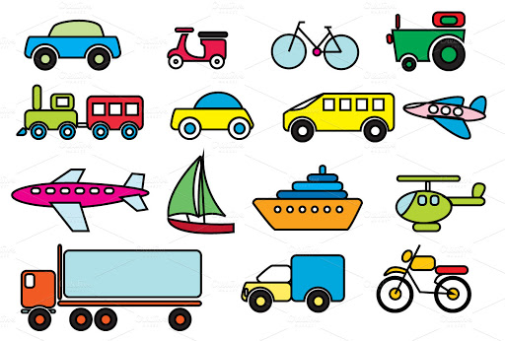
Dobwalls Primary School Medium Term Plan EYFS Summer 1st half
Literacy
We will begin the half term by introducing our new story ‘Faster, Faster.’ This is a story from the ‘Little Red Train’ series and will encourage the children to learn and use new vocabulary. The children will learn an extract from the story with a text map and have a go at writing their own version of the story. Our next focus text will be a non- fiction book, ‘Vehicles.’ we will learn about the differences between fiction and non-fiction books and have a go at writing instructions for how to make a model of a vehicle. Our daily phonics sessions will continue in smaller groups to suit specific needs.
Mathematics
In maths we will be progressing in our number to work with numbers up to 20. We will spend lots of time ensuring the children’s understanding of numbers 11 -20 is secure; children will explore tens and ones, make bigger numbers with maths equipment and use jottings to record their findings. We will be cementing the children’s understanding of adding, subtracting, comparing and finding number bonds with-in this range. In our shape, space and measure unit, the children will be exploring more complex patterns using at least three variables. We will also explore patterns in number sequences.
Personal, Social and Emotional Development
This half term we will be exploring the ‘1 decision’ materials to focus our discussions on growing and changing . We will be learning about supporting charities and taking part in events such as sports day. A ‘friendship stop’ will be introduced in our garden area and the children will be taught how to use this to support developing relationships with others. EYFS will continue to develop their understanding of the diamond rules.
TRANSPORT
Physical Development
In our P.E sessions, we will be beginning by exploring a range of movement and dance focussed around vehicles. The children will have the opportunity to create their own dance based on a vehicle of their choice. We will also be enjoying some team games involving throwing, aiming and running in preparation for sports day later in the summer term. We will have short daily handwriting sessions to support the children’s pencil grip, letter formation and fine motor control. Our finger gym will be updated with some more challenging activities!
Communication and language
In EYFS we will continue to develop children’s language and vocabulary through weekly story and rhyme focuses. There will be lots of opportunities for children to practice and embed these skills in their continuous provision and adult led sessions.
Understanding the world
The children will be finding out about various types of transport; trains, cars, aeroplanes etc. We will be learning about the different uses of vehicles and have a focus on Emergency vehicles and their purpose. We will also be planting seeds in our garden and observing the changes that we see. We will use digital photography to record and monitor our findings. Towards the end of the half term we will learn about lighthouses and what their purpose is. The children will make their own light house with a working light.
Expressive Arts and Design
Our role play enhancement will be transformed into a mechanics workshop for this half term to allow the children to take on a range of different characters in their play and support our topic learning. We will be learning lots of new songs about different vehicles and using percussion instruments to explore the different sounds of a train and other vehicles. There will be lots of opportunities to design and construct large and small vehicles using a range of different materials and equipment.
Wild Tribe
This half term we will be exploring how our environment changes through from spring to summer. There will be lots of activities on offer including boat building and nature hunts. Children will be encouraged to use their independence skills widely.

