Slide 1
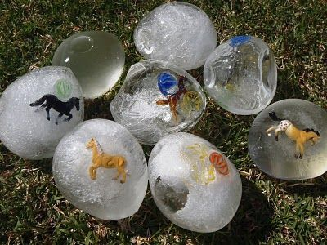
Dobwalls Primary School Medium Term Plan EYFS Spring 1st half
Literacy
We will begin the term with a focus on the story ‘The Gruffalo’s Child.’ The winter setting fits in perfectly with our ‘ice and snow’ topic which we will launch with this book. The class will learn a section of this story by using a text map and actions. There will also be plenty of opportunities to use ‘have a go’ writing skills linked to this text. We will then move on to an ‘author focus’ on Julia Donaldson and enjoy several of her other stories. Our daily Read Write Inc sessions will continue to support the class in their developing phonic skills.
Mathematics
We will be following the White Rose maths guidance for EYFS Spring Term. We will begin the term by recapping our number knowledge to 5 with a particular focus on finding number bonds (combinations of 2 numbers) for numbers up to 5. We will then progress to developing number to knowledge and understanding for numbers up to 10. We will begin with counting objects (moveable and non-moveable) to 10 and comparing groups of objects up to 10. When secure with numbers to 10, we will be combining groups of objects to find a total up to 10 (adding). Along with our daily adult led sessions, children will be able to develop their skills during continuous provision.
Personal, Social and Emotional Development
This half term we will be looking at developing confidence and building relationships. We will introduce a ‘friendship stop’ in our outside area for children to use to find a friend and look out for others. We will continue to reinforce the school diamond rules daily to support our positive behaviour expectations. The ‘1 decision’ materials will again be explored to address issues like feeling scared, adjusting to change and jealousy.
Ice and Snow
Physical Development
We will be ensuring all children have a confident tripod pencil grip and use this to now form all letters correctly. Independence skills will be cemented ensuring all children can independently put on shoes, coats and jumpers. In our P.E sessions we will focus on gross motor skills like balancing, climbing, jumping and moving with control. We will have the opportunity to use the gymnastics apparatus in the hall to develop these skills. We will also continue to progress through the ‘Leap into Life’ programme.
Communication and language
This term we will continue to use our class ‘rhyme of the week’ to develop language and vocabulary. Role Play will be a big focus with a real stage appearing in the classroom! Children will be re-enacting our class stories and rhymes as well as our exciting visit to Plymouth Theatre Royal to watch a live show.
Understanding the world
Children will be learning about very cold places. We will have a focus on the Arctic and Antarctic and use maps and globes to identify them. The children will find out how ice forms and what it would be like to live in extreme conditions. There will be lots of opportunities to study how ice is created and how and what causes it to change.
In other areas we will be learning about The Chinese New Year and taking part in some traditional celebrations. We will also be finding out about pancake day and lent.
Expressive Arts and Design
We will be using our ‘ice and snow’ theme as inspiration for creativity . We will be creating cold themed pictures, ice sculptures and snowy scenes as well as experimenting with ‘snow’ art in our outside environment. Once again our class text ‘The Gruffalo’s Child’ will be used as a stimulus to create 2D and 3D representations of the story.
Our Chinese New Year theme will provide lots of opportunity for creativity including making dragons and designing a Chinese inspired meal!
Wild Tribe
This half term we will be looking at how our outside environment is changing as winter settles in. We will be using nature to make various sculptures and models. We will base many of our activities on our class text ‘The Gruffalo’s Child;’ making animal homes and Gruffalo traps!

